Slide 1
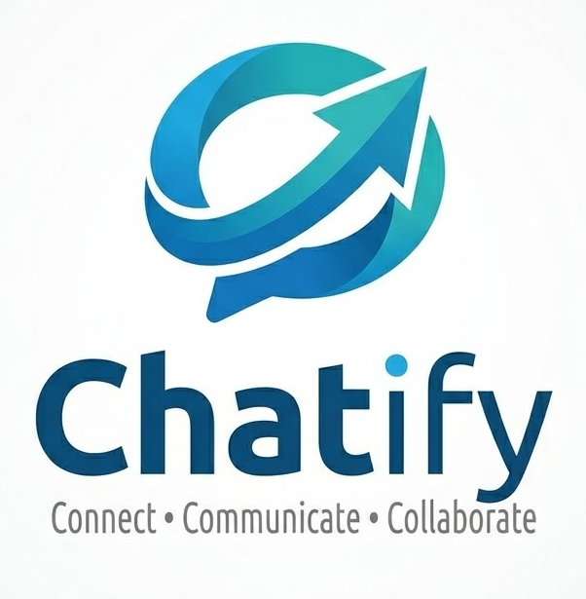
CHATIFY Using MERN Stack
MCA Semester-II Project
R.B. Institute of Management Studies (RBIMS)
Guide: Pro. Himani Khodifad

Slide 2
Introduction
PROJECT INTRO IN SHORT
The Real-Time Chat Application is a web-based communication platform developed using the MERN Stack. It enables users to communicate instantly through secure messaging. The system supports user authentication, profile management, and real-time message exchange using Socket.IO technology.

Slide 3
Problem Statement
FACED DURING PEOJECT DEVELOPMENT
Traditional messaging systems often face issues such as delayed communication, lack of real-time updates. The objective of this project is to develop a secure, efficient, and scalable chat application that provides instant communication and a better user experience.

Slide 4
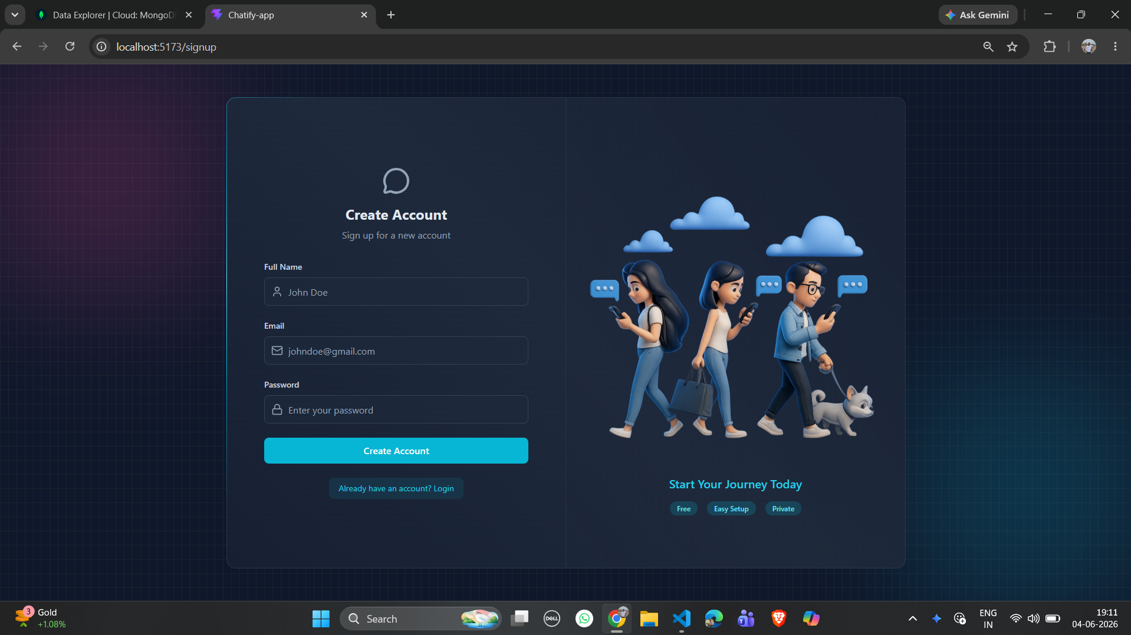
Project Objectives
SIGN UP PAGE - CHATIFY

Slide 5
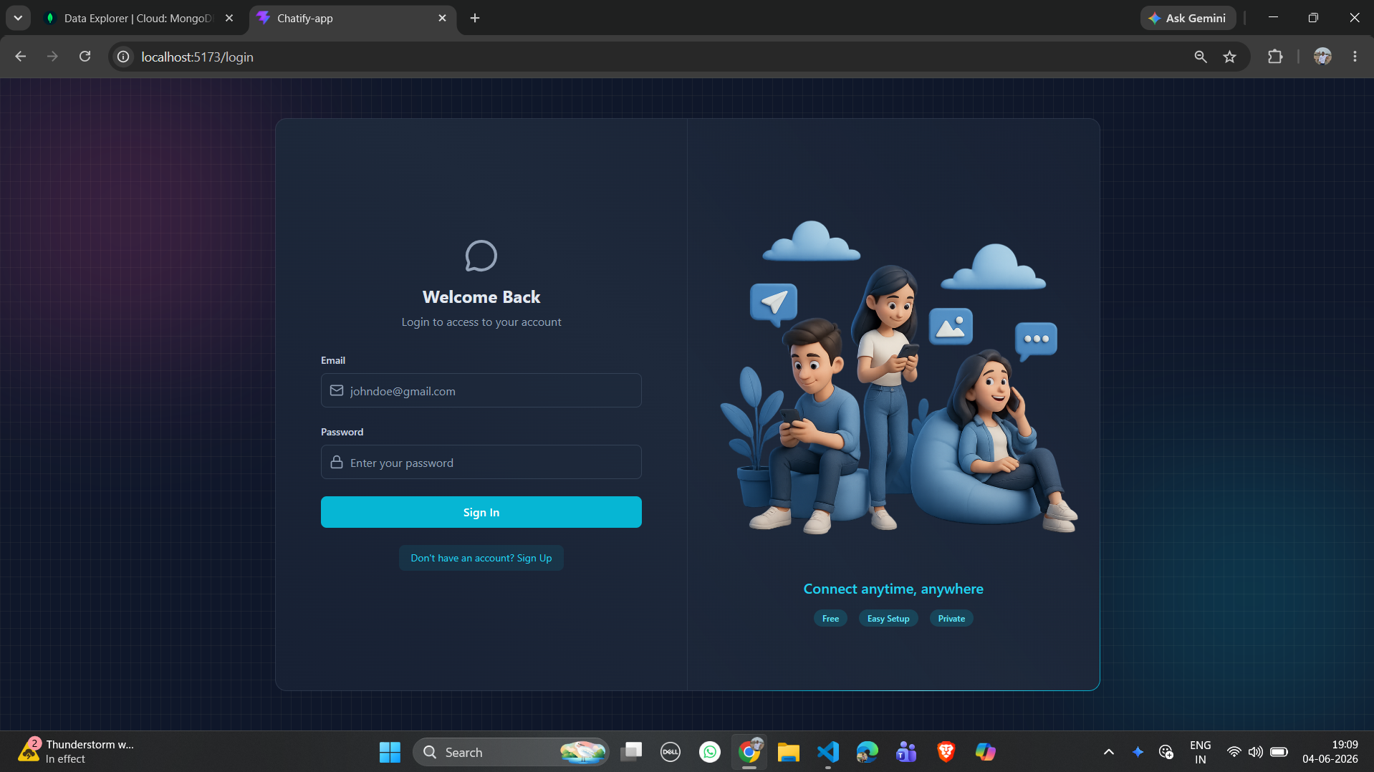
Project Objectives
LOGIN PAGE - CHATIFY

Slide 6
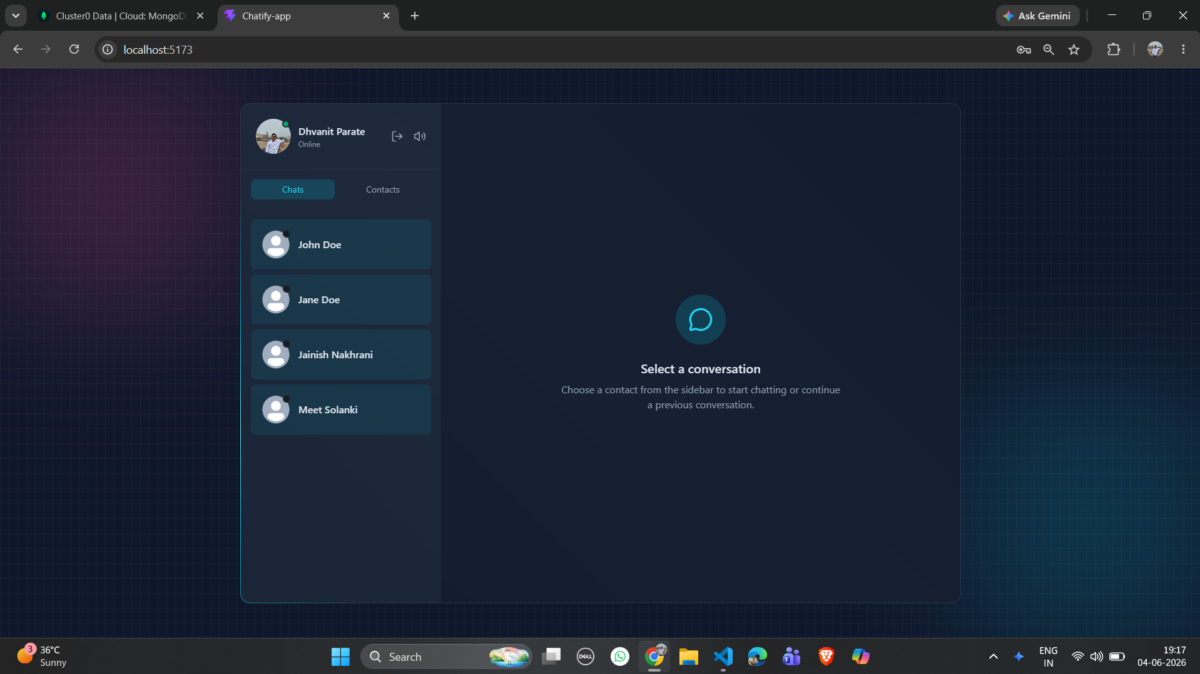
Project Objectives
HOME PAGE - CHATIFY

Slide 7
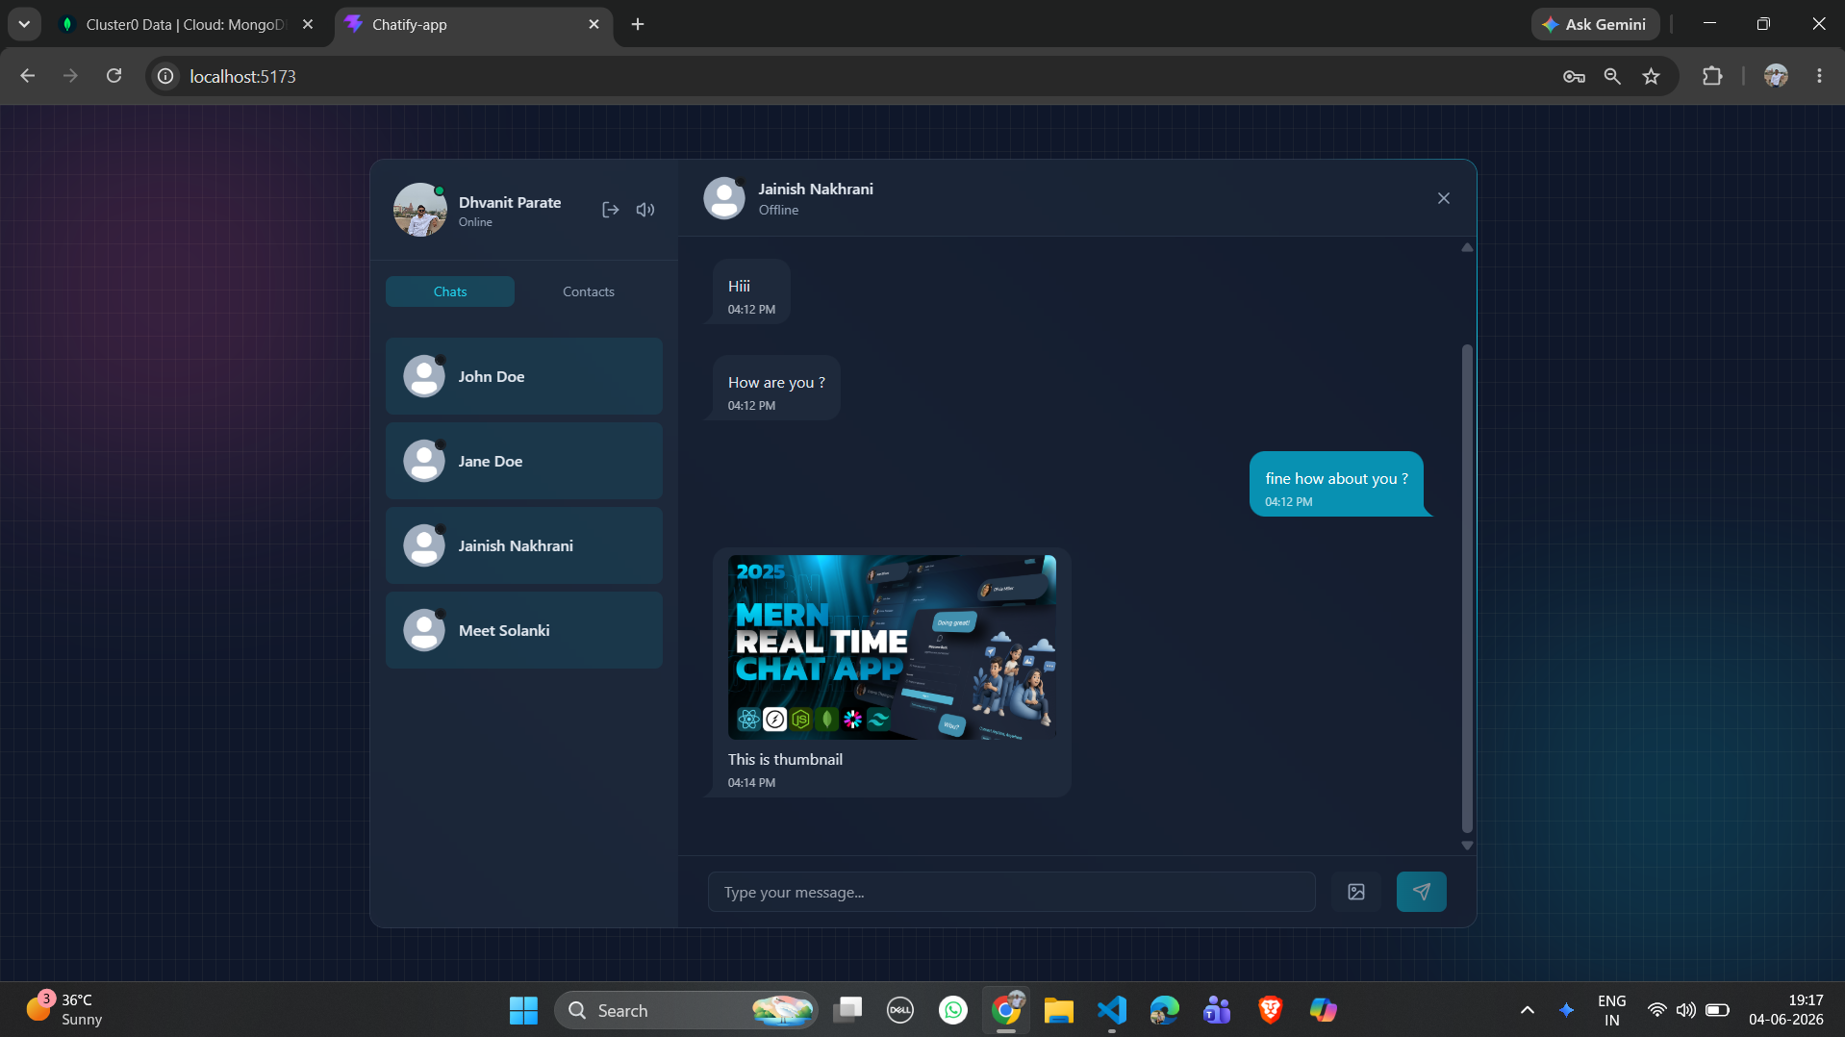
Project Objectives
CHAT PAGE - CHATIFY

Slide 8
Technologies Used
Frontend
React.js – Backend Framework
HTML5
CSS3
JavaScript
Backend
Node.js – Runtime Enviroment
Express.js
Database
MongoDB
Additional Tools
Socket.IO
Thunder Client – API Testing
Git & GitHub
JWT
Cloudinary

Slide 9
System Architecture
Three Tier Architecture
Frontend Layer (React.js)
HTTP / Socket.IO
Backend Layer Node.js + Express Socket.IO
Presentation Layer → React.js Frontend
Application Layer → Node.js, Express.js, Socket.IO
Data Layer → MongoDB Database
Database Layer MongoDB

Slide 10
System Architecture
Frontend Layer
Technologies
React.js
HTML5
CSS3
JavaScript
Responsibilities
User Registration & Login
Display Chat Interface
Send Messages
Receive Real-Time Messages
Show Online Users
Manage User Sessions
Features
Responsive UI
Real-time message updates
User profile management
Chat list and conversation window

Slide 11
System Architecture
Backend Layer
Technologies
Node.js
Express.js
Socket.IO
JWT Authentication
Responsibilities
User Authentication
API Management
Message Processing
Real-Time Communication
Database Operations
Main Modules
Authentication Module
User Management Module
Chat Management Module
Message Handling Module
Socket.IO Server
Working
Receives requests from React frontend.
Validates users.
Stores messages in MongoDB.
Broadcasts messages instantly using Socket.IO.

Slide 12
React JS
React.js is the frontend library used to build the user interface (UI) of the chat application.
Functions in the Chat Application
Creates an interactive and responsive user interface.
Displays chat messages in real time.
Manages application state (users, chats, messages).
Handles user interactions such as login, signup, and sending messages.
Updates only the changed parts of the page without reloading.
Communicates with the backend APIs and Socket.IO server.

Slide 13
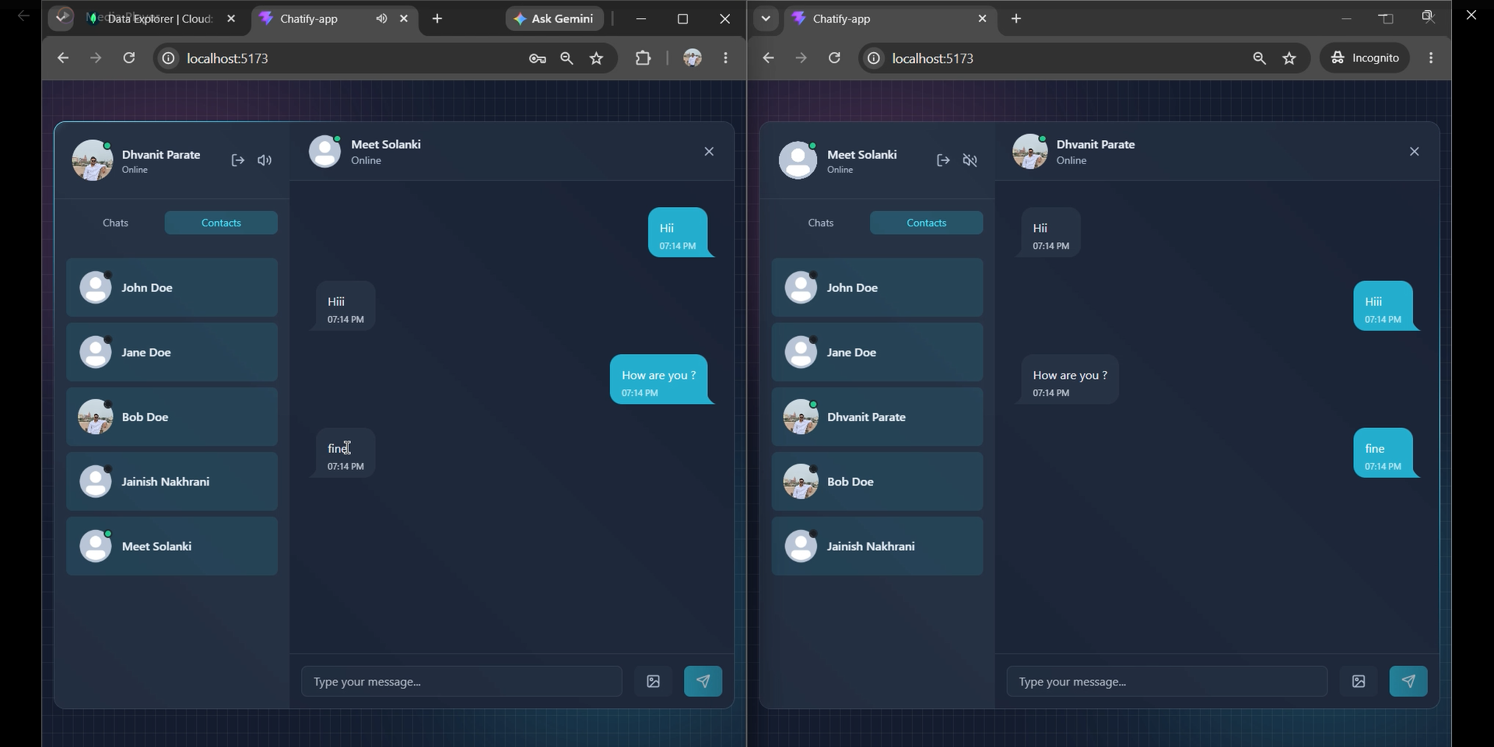
Node.js and Express.js
EXPRESS.JS – CHATIFY

Slide 14
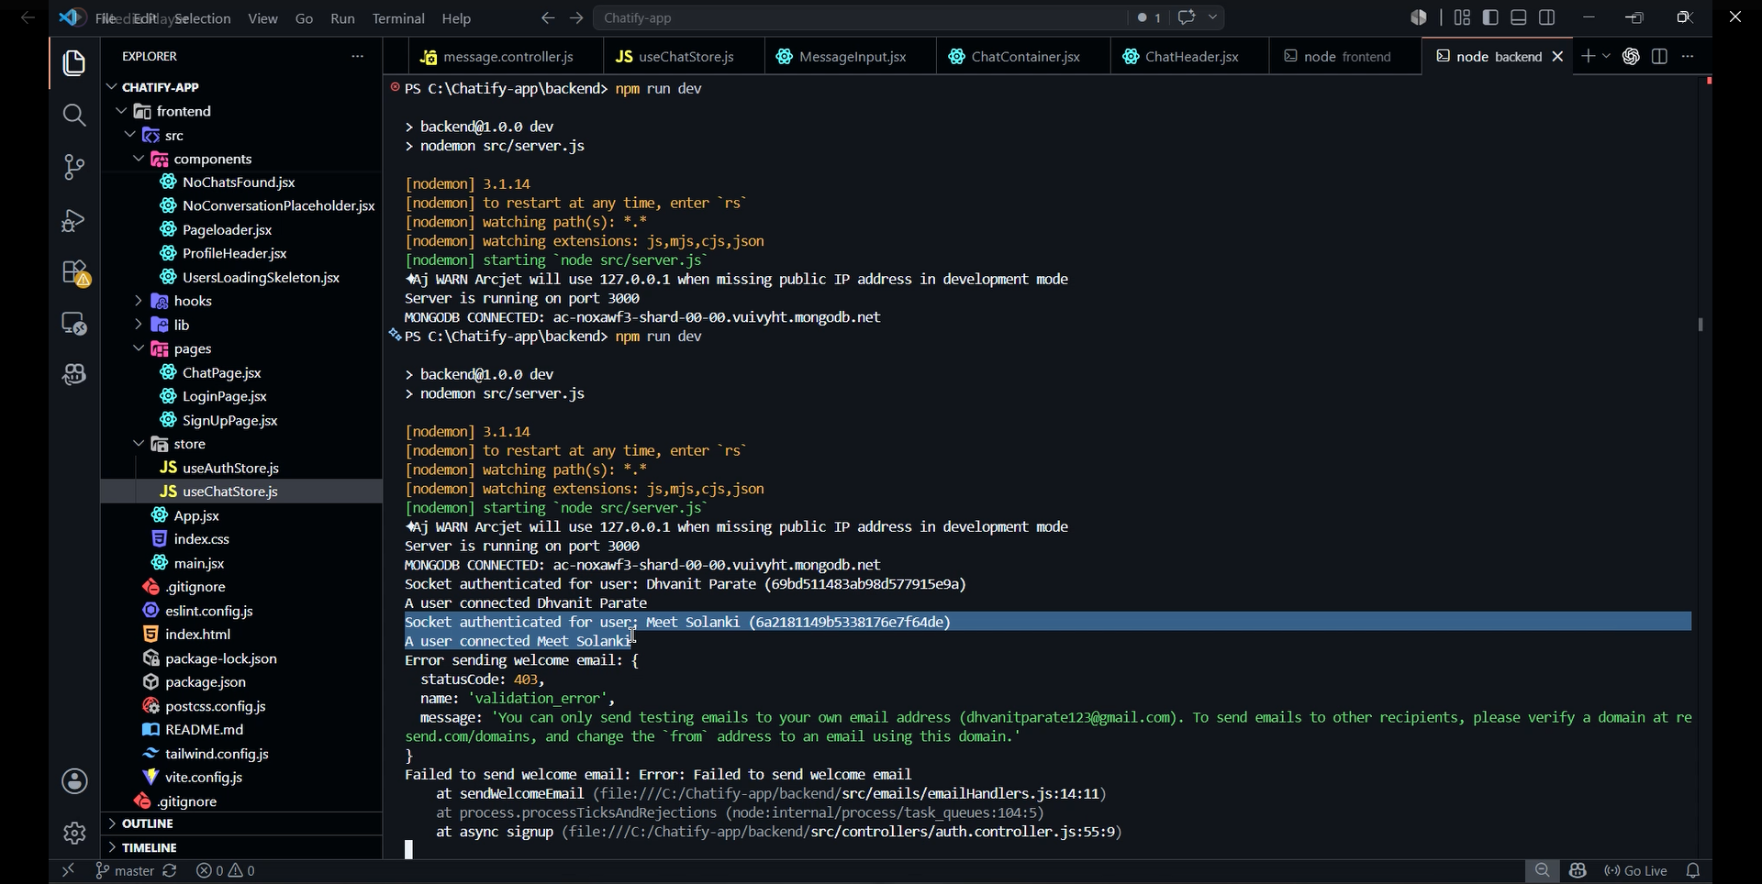
Node.js and Express.js
NODE.JS – CHATIFY

Slide 15
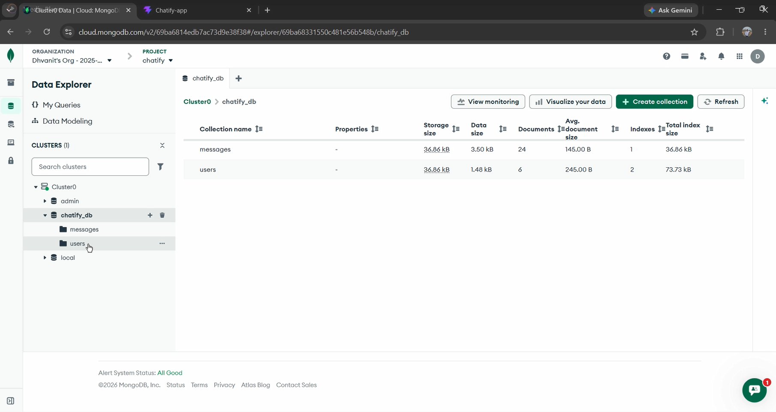
MongoDB
STORES USER AND APPLICATION DATA - CHATIFY

Slide 16
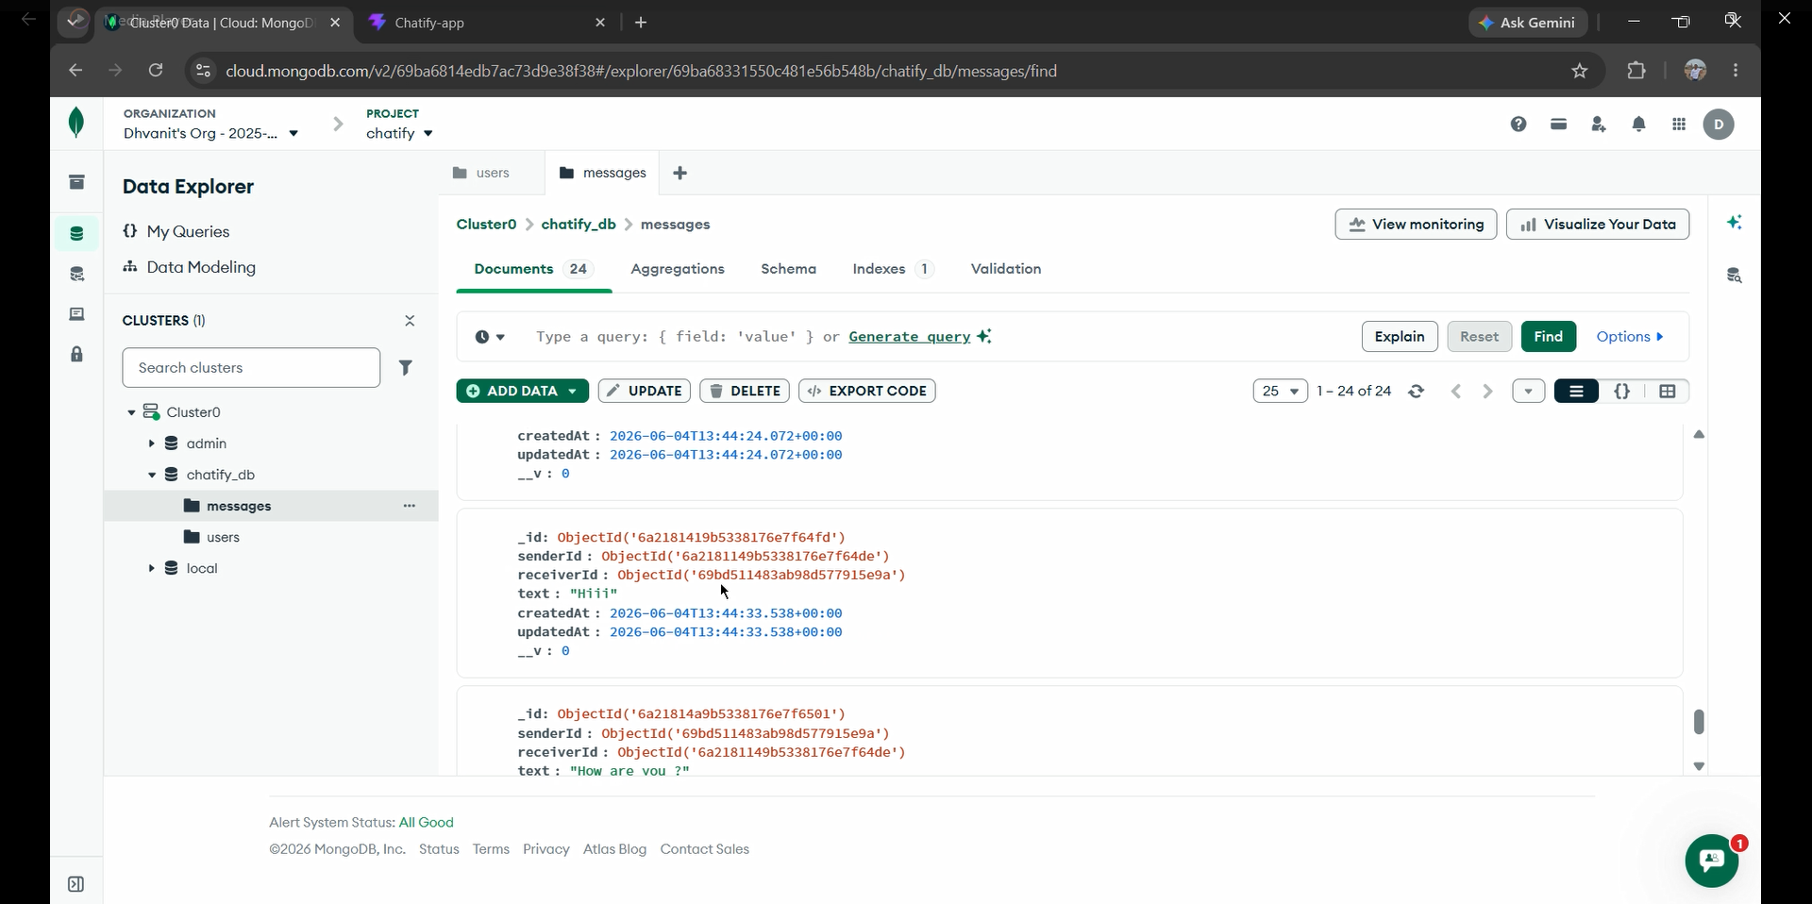
MongoDB
STORES CHAT DATA - CHATIFY

Slide 17
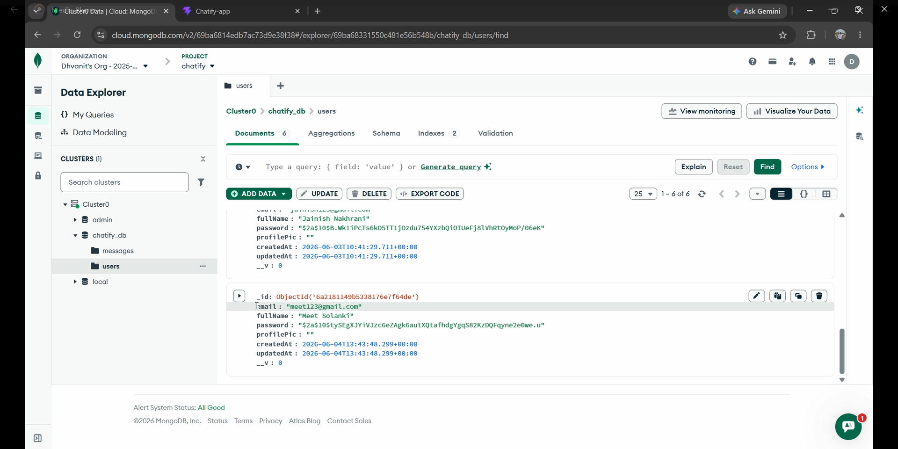
MongoDB
STORES APPLICATION DATA (USER) - CHATIFY

Slide 18
API Testing
Thunder Client is a VS Code extension used for API testing.
Used to test backend endpoints before frontend integration.
GET – Retrieve data from the server.
POST – Send new data to the server.
PUT – Update existing data.
DELETE – Remove data from the database.
Verifies API responses, status codes, and data accuracy.
Helps identify and fix backend errors efficiently.

Slide 19
Advantages
Real-time messaging without page refresh.
Secure user authentication and authorization.
Responsive and user-friendly interface.
Fast performance using React.js.
Efficient data storage with MongoDB.
Supports multiple users simultaneously.
Scalable and easy to maintain.
Demonstrates complete MERN Stack development.

Slide 20
Future Scope
Voice and video calling.
Group chat functionality.
File and media sharing.
End-to-end message encryption.
Read receipts and typing indicators.
AI chatbot integration.
Mobile app development.
Multi-language support.
Push notifications.
Cloud deployment for scalability.

Slide 21
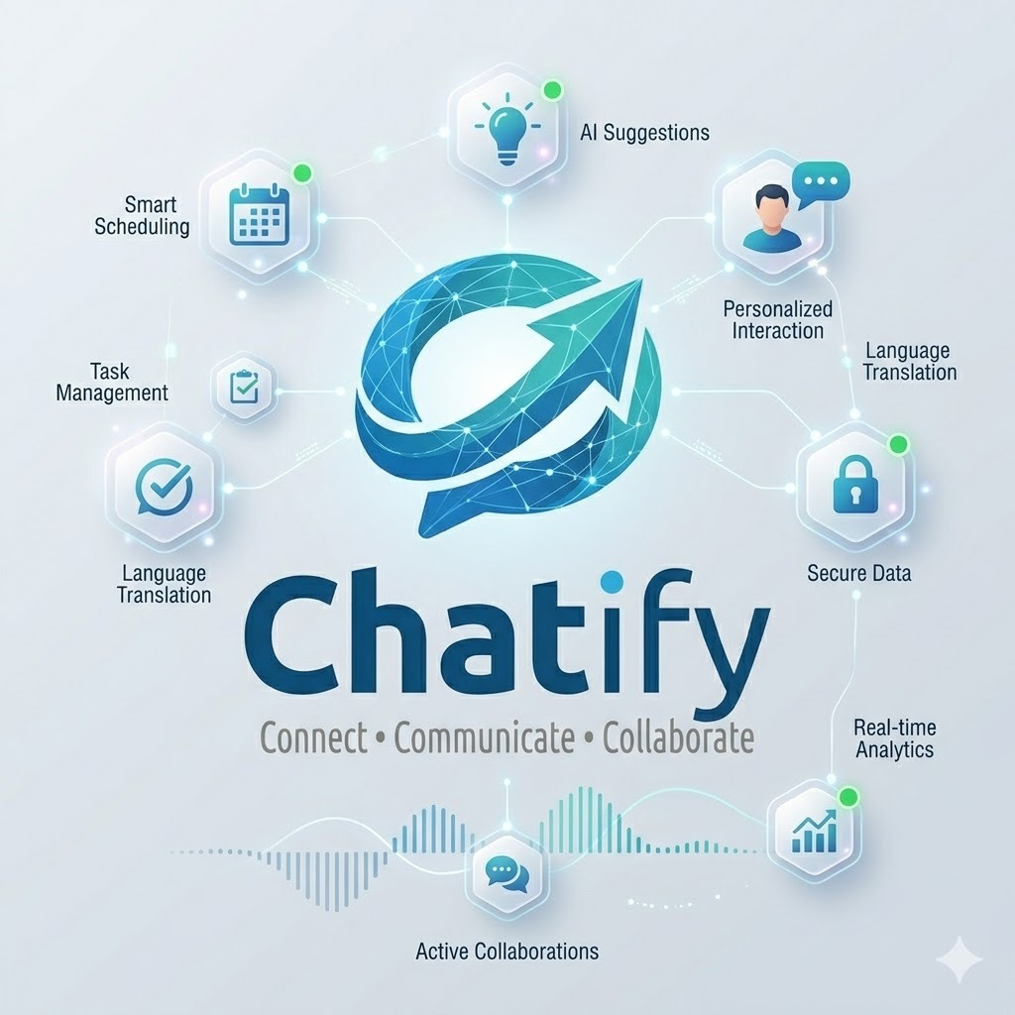
Future Scope

Slide 22
Conclusion
The Real-Time Chat Application Using MERN Stack successfully provides a secure, efficient, and user-friendly platform for instant communication. By integrating MongoDB, Express.js, React.js, Node.js, and Socket.IO, the application enables real-time messaging, user authentication, and reliable data management. The project demonstrates the practical implementation of modern full-stack web development technologies while ensuring scalability, responsiveness, and a seamless user experience. Overall, it serves as an effective solution for real-time communication and provides a strong foundation for future enhancements such as voice/video calling, group chats, and advanced security features.

Slide 23
Thank You

